Slide 1
Automated Configuring of DBMS through Machine Learning
D.L.H.P. Priyadarshana
Seminar presentation | Principles of data & knowledge based systems | wise18

Slide 2

DBMS : WHY SO IMPORTANT?
Provide a way to store and retrieve database information
‘conveniently’ and ‘efficiently’
File System | DBMS
Less security | More security
Best to store small amounts of data | Suitable to store large amounts of data
No restrictions on duplicate data | Avoid duplicate data
Cannot define relationships between records | Possible define relationships between data using Primary Key & Foreign Key constraints
Cannot perform criteria based data selection | Easy to search for data that follows a particular criteria

Slide 3
DBMS TUNING : WHY – WHAT – HOW ?
Data contributes to an organization’s competitive advantage:
Data : relevant, organized, accurate, easily accessible
e.g., Access time is critical for a medical system application
DBMS performance slows dramatically as both data and the business grow
Needs to be tuned!
Configuration of memory and processing resources of the computer running the DBMS
Proper memory allocations for cache usage,
Setting the frequency for writing data to storage,
Assign network protocols to communicate, etc.
Involves tuning hundreds of configuration knobs controlling almost all aspects of DBMS
WHY
WHAT
— HOW

Slide 4
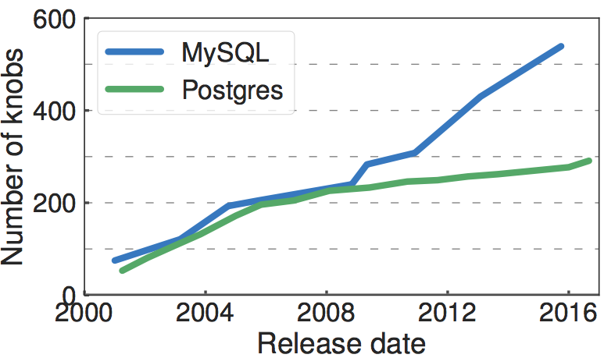
MANUAL VS AUTOMATED TUNING
Standard Approach Hire an Expert Database Administrator (DBA)
manually adjust configuration knobs using experience + ‘trial-and-error’ approach
becoming increasingly difficult:
high number of configurable knobs
continuous knob settings
inter-dependent knobs
each deployment is configured from scratch!
~250 new configuration options added to MySQL between 2012 and 2016 ^{[1]}
[1] Van Aken, Dana, et al. "Automatic Database Management System Tuning Through Large-scale Machine Learning." International Conference on Management of Data. ACM, 2017.

Slide 5
MANUAL VS AUTOMATED TUNING
Standard Approach Hire an Expert Database Administrator (DBA)
manually adjust configuration knobs using experience + ‘trial-and-error’ approach
becoming increasingly difficult:
high number of configurable knobs
continuous knob settings
inter-dependent knobs
each deployment is configured from scratch!
Auto-tuners – Tools which can automatically configure DBMS knobs
Expected to automatically find knob configurations for
best DBMS performance (high throughput, low latency, low cost, etc.)
Weaknesses:
DBMS specific (PGTune for Postgres, Oracle SQL analyzer tool)
Require DBA’s input (DB2 Performance Wizard tool by IBM) DOES NOT REUSE PAST DATA!!!
~250 new configuration options added to MySQL between 2012 and 2016 ^{[1]}
[1] Van Aken, Dana, et al. "Automatic Database Management System Tuning Through Large-scale Machine Learning." International Conference on Management of Data. ACM, 2017.

Slide 6
MACHINE LEARNING FOR AUTO-TUNING
OtterTune
An ‘auto-tuner’ capable of reusing past tuning-data.
Developed by a set of researchers in the ‘Carnegie Mellon Database Group’
What’s so special ‘bout it?
“Make it easy for anyone to deploy a DBMS,
even with zero expertise in database administration!”

Slide 7
MACHINE LEARNING FOR AUTO-TUNING
OtterTune
An ‘auto-tuner’ capable of reusing past tuning-data.
Developed by a set of researchers in the ‘Carnegie Mellon Database Group’
What’s so special ‘bout it?
Capable of reusing knowledge gained from previous tuning attempts
Works on any DBMS
Minimum input requiring from DBA
Use ML models at different stages of the process
Can produce best knob config. recommendations within a short time
Can incrementally predict better knob configurations using new tuning data
ML models written in Python and it’s open-source ( https://github.com/cmu-db/ottertune )
“Make it easy for anyone to deploy a DBMS,
even with zero expertise in database administration!”
Utilize
Past
DBMS
Tuning Data
Train
Machine
Learning
Models
Tune
New
DBMS
Deployments

Slide 8
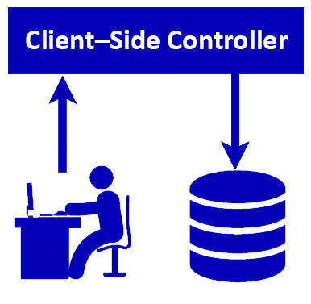
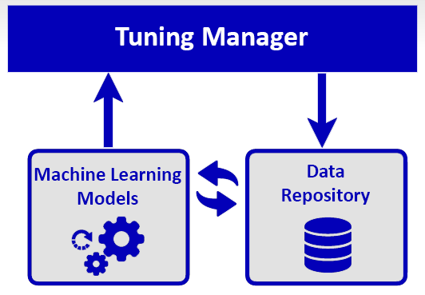
ARCHITECHTURE
OtterTune

Slide 9
1ST COMPONENT : CLIENT–SIDE CONTROLLER
OtterTune
At the beginning of each tuning session,
DBA specify the ‘Target Objective’(high throughput, low latency, etc.)
Controller starts the ‘observational period’
on the target DBMS
During ‘Observational Period’:
Collect initial knob configurations & DBMS runtime statics
Execute workload traces or queries given by DBA
Maintain minimum interaction with DBMS
Collect same set of initially gathered internal metrics
1
2
2
1
Target Objective + Internal Metrics

Slide 10
OtterTune
2ND COMPONENT : TUNING MANAGER
Target Objective + Internal Metrics
Tuning Manager:
Store received information in repository
Use repository data within OtterTune’s
‘ML Pipeline’ to compute next configurations
Return recommended knob configurations
+
Expected improvement in Target Objective
DBA review
Recommendations
3
4
3
5
5
4
Controller
Accept and Install
6
Reiterate for better recommendations

Slide 11
ML PIPELINE
OtterTune
Workload Characterization
Pick the minimal set of metrics to identify the workload
Knob Identification
Identify the most critical knobs that affects the DBMS performance
Automated Tuning
Recommend knob settings to improves performance

Slide 12
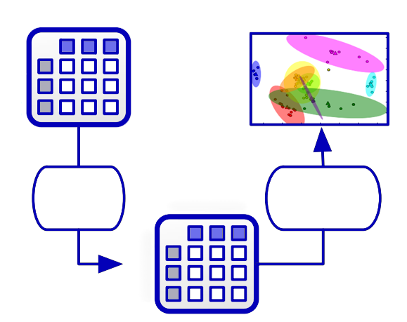
ML PIPELINE: WORKLOAD CHARACTERIZATION
OtterTune
Small set of distinct Metrics to identify workload
Workload Characterization
Runtime-Metrics
One representative Metric from each cluster
Samples
Knob Identification
Phase 1
Dimensionality Reduction
Factor Analysis
Phase 2
Clustering
K-means
Factors
Automated Tuning
Samples
Redundant Metrics
e.g., Correlated,
Same measurement – Different Units

Slide 13
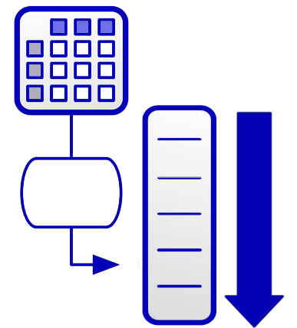
ML PIPELINE: KNOB IDENTIFICATION
OtterTune
Knobs
Workload Characterization
Most
Impactful
Knobs on
Performance
Samples
Knob Identification
Famous feature engineering method
Identifies relevant knobs
Assigns low weights to noisy knobs
Rank Importance of knobs using Lasso
Importance
Automated Tuning
Incrementally increase
# knobs used for tuning
(not too much – not too less)

Slide 14
ML PIPELINE: AUTOMATED TUNING
OtterTune
2 Step-Approach:
Phase 1 : Match target workload to similar workload in repository
Measure similarity by computing ‘average metric distance’
Phase 2 : Generate configuration recommendations to optimize ‘Target Objective’
Similar workload data used to train ‘Gaussian Process’ model
– Predict ‘Target Objective’ values for sample set of possible configurations
– Optimize next knob configurations using ‘Exploration vs Exploitation’ framework
(explore configurations near current best with the sole purpose of
exploiting a better Target Objective)
Workload Characterization
Knob Identification
Automated Tuning
Expected Improvement + Knob Configuration Recommendations

Slide 15
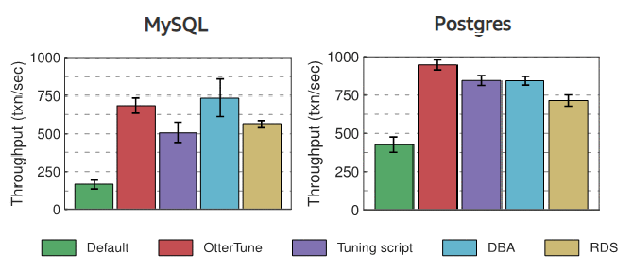
OTHERS VS OTTERTUNE
OtterTune
Experiment conducted on Amazon EC2
Throughput equal or better than the rest!
OtterTune produce 94% of
DB experts generated configurations
within 60 mins!^{[1]}
Throughput of MySQL and Postgres for configurations
generated by different tuning agents^{[1]}
[1] Van Aken, Dana, et al. "Automatic Database Management System Tuning Through Large-scale Machine Learning." International Conference on Management of Data. ACM, 2017.

Slide 16
THANK YOU!

